Slide 1
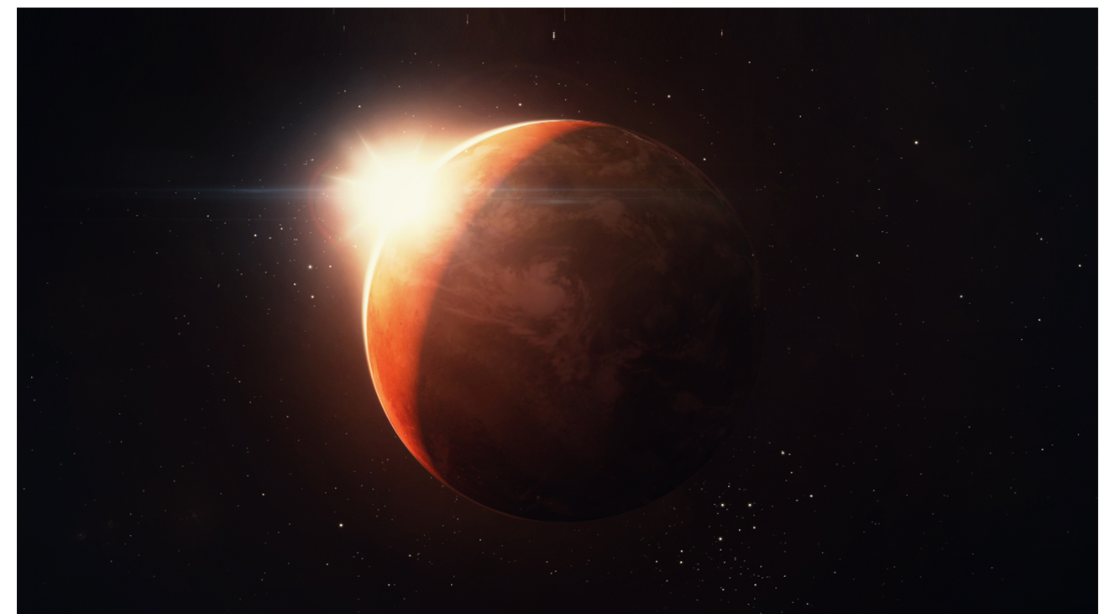
Journey To Mars
By Mike Zhu
and
Ben Zhang

Slide 2




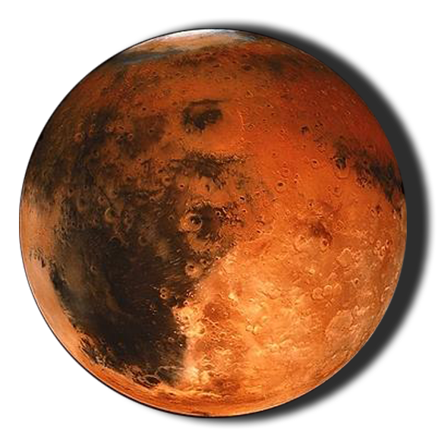

Fly Across Space in 3 Awesome Spaceships
Fly 3 awesome spaceships
Exterminate
the hostile aliens
Equipped with 3 unique weapons
Conquer Mars!
Vaporize Dangerous Asteroids

